Slide 1







































































FINAL SEMINAR
DESIGN OF MODBUS GATEWAY ON MONITORING SYSTEMS WITH MODBUS PROTOCOL
BY
ELECTRONIC ENGINEERING
FAHRIAN M RAFLI
2122500038
ADVISOR 1
ADVISOR 2
ARDIK WIJAYANTO, S.T., M.T.
NIP. 197706202002121002
TAUFIQURRAHMAN, S.ST., M.T.
NIP. 198309202008121001

Slide 2

RESEARCH BACKGROUND
One of the main challenges in developing monitoring systems is the need to integrate multiple devices with varying protocols. This complexity increases with the increasing number and types of sensors used in industrial environments.

Slide 3



FORMULATION OF THE PROBLEM
How to read Slave using Modbus RTU then convert it to Modbus TCP.
How to build a system that can stably read multiple Slaves.
How to build a Dashboard to display data on Modbus Gateway.

Slide 4

SCOPE
The communication modes used in this project are Modbus RTU and Modbus TCP.
The data displayed on the Dashboard is only 3 Nodes with various parameters, but can be connected to 3 more Modbus devices.
Modbus sensor data will be processed and sent to firebase and Node-Red for Modbus TCP.

Slide 5


PROJECT GOAL
The expected output is a Modbus Gateway that is able to receive data from various Slaves using Modbus RTU communication which will then be sent to Firebase and also formatted into Modbus TCP. The System is designed to be able to communicate with various Modbus sensors that are connected

Slide 6


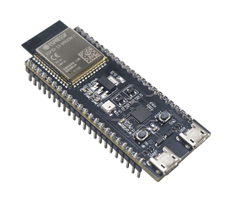



BLOCK DIAGRAM SYSTEM
SLAVE AREA
MASTER AREA
NODE-RED
NODE UNIVERSAL
RS485
PZEM-004T
MODBUS GATEWAY
DASHBOARD
XY-MD02

Slide 7
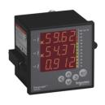

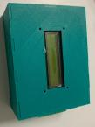
NODE 1
PM1200
WATER QUALITY SENSOR
A+
B-
TEMPERATURE SENSOR

Slide 8






MAIN BLOCK DIAGRAM
TCP CLIENT
MODBUS TCP
ESP32-S3
REALTIME DASHBOARD
RTC
I2C
JSON
REQUEST DATA FROM FIREBASE
SPI
TTL TO RS485
CONVERTER
SDCARD
SLAVE

Slide 9
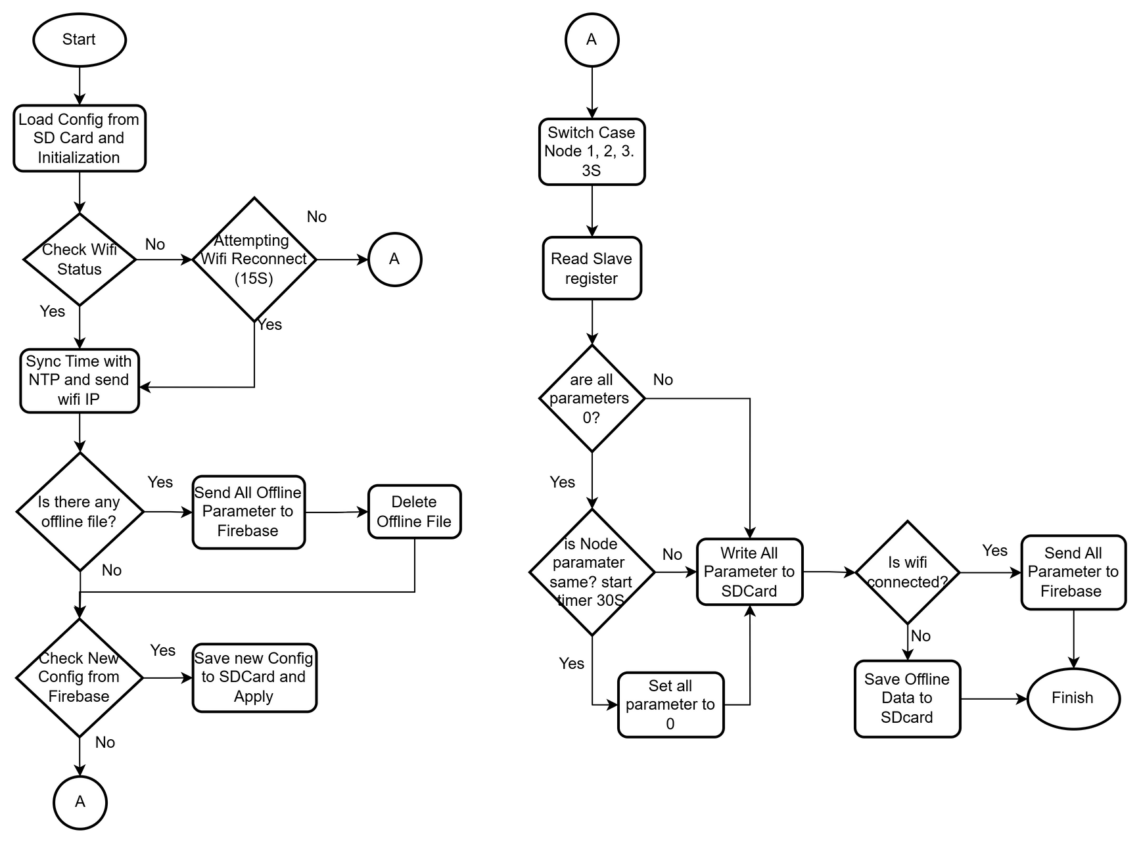
FLOWCHART

Slide 10
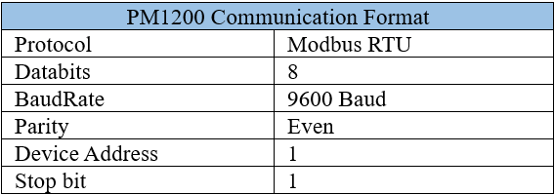
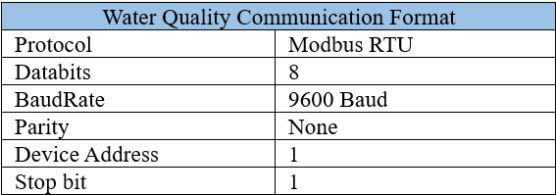
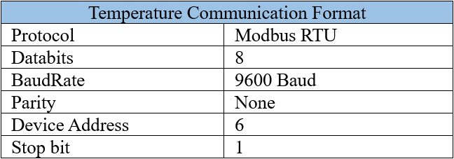
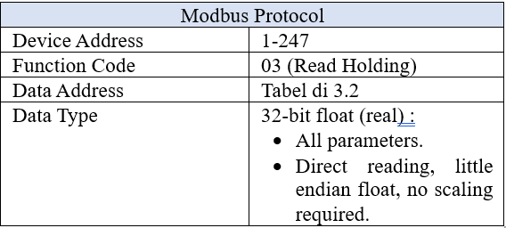
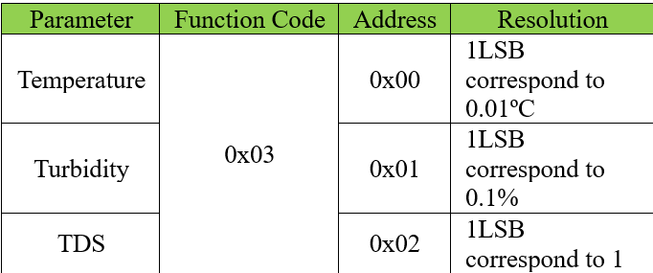
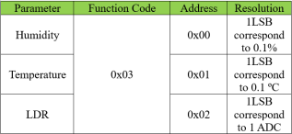

NODE UNIVERSAL REGISTER AND FORMAT
Power Meter 3-Phase PM1200
Water Quality Sensor
Temperature Sensor

Slide 11
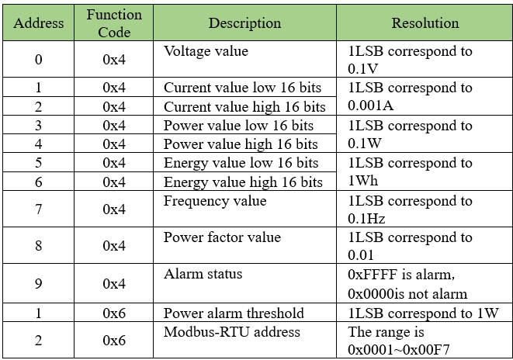
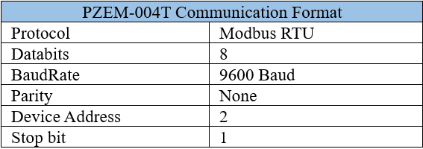
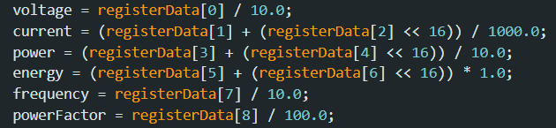
PZEM-004T REGISTER AND FORMAT

Slide 12
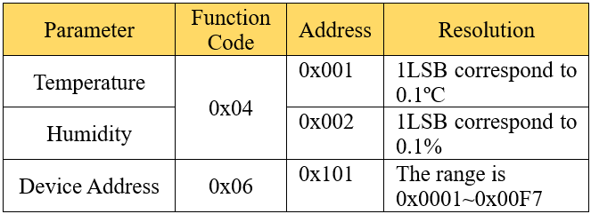
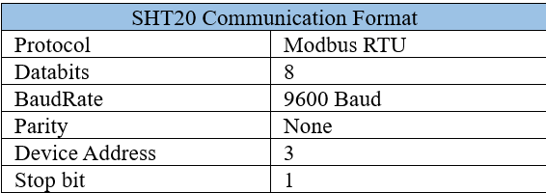

XY-MD02 REGISTER AND FORMAT

Slide 13
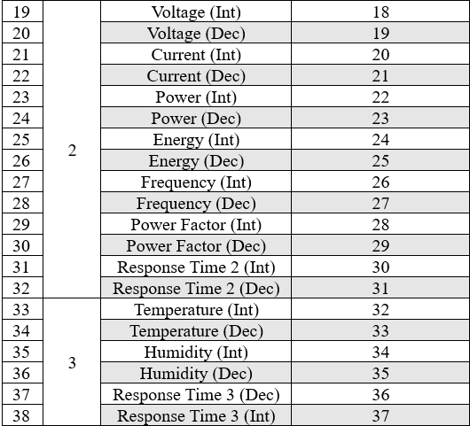
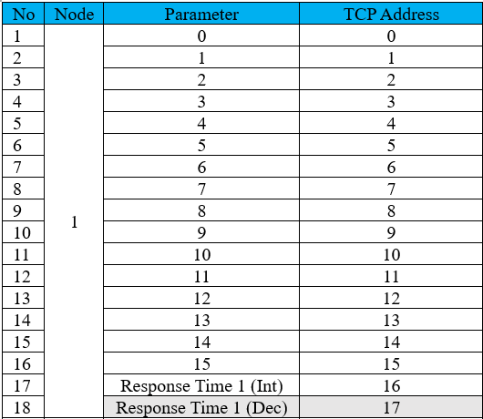
MODBUS TCP ADDRESS

Slide 14
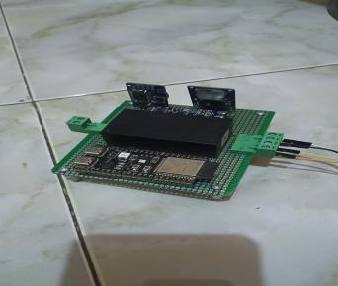
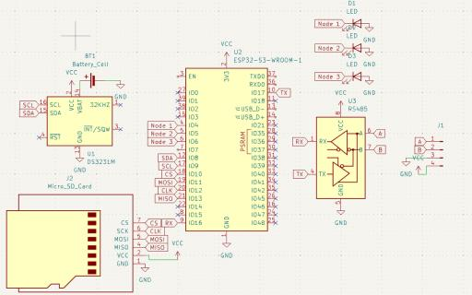
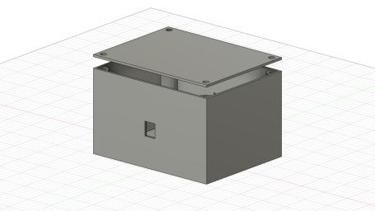
HARDWARE DESIGN

Slide 15
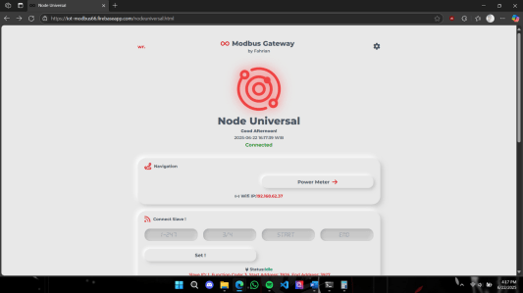
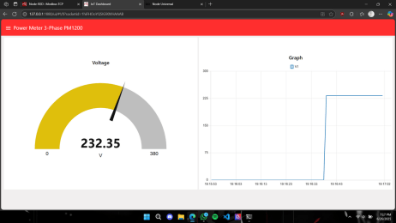
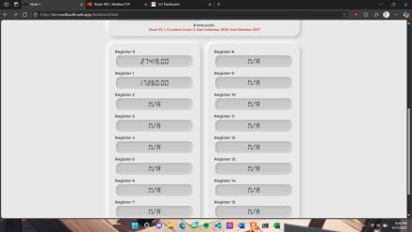
Dashboard Firebase
DASHBOARD
Dashboard Node-RED

Slide 16
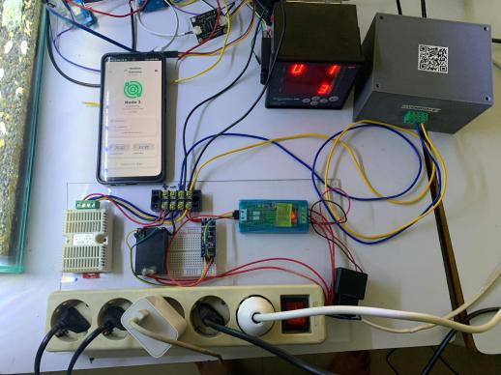
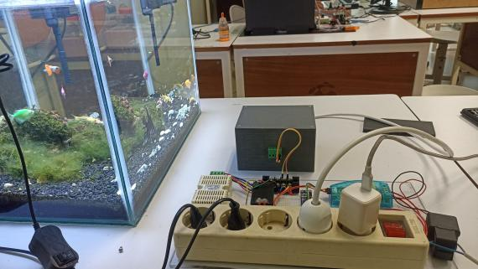
FIELD TESTING

Slide 17
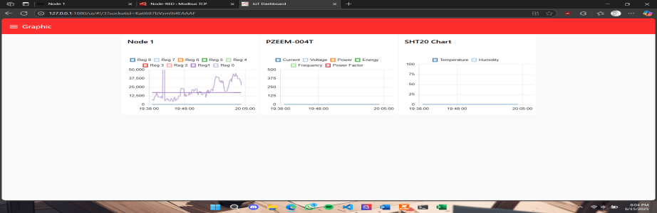
DATA TESTING
Power Meter 3-Phase PM1200

Slide 18
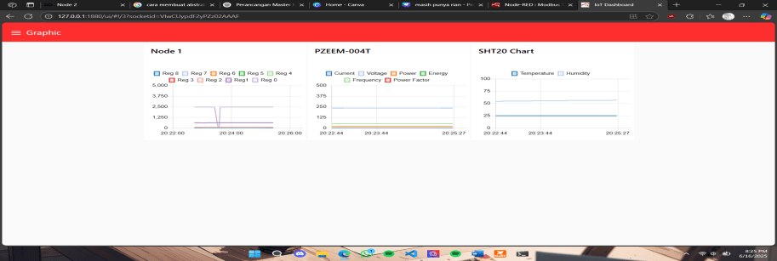
DATA TESTING
Water Quality Sensor

Slide 19
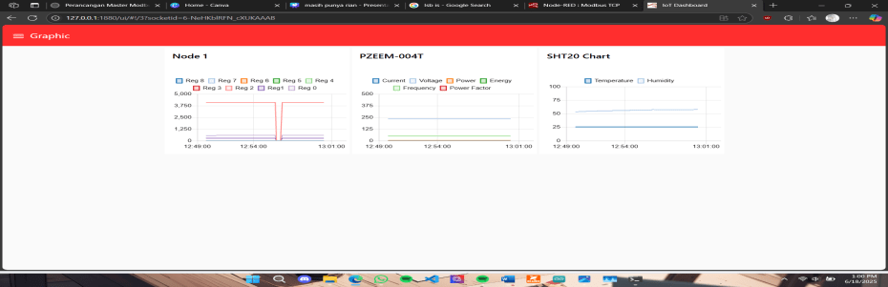
DATA TESTING
Temperature Sensor

Slide 20
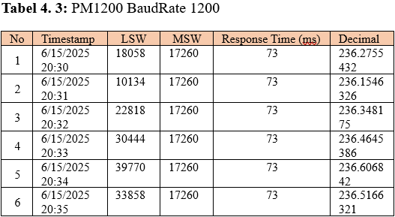
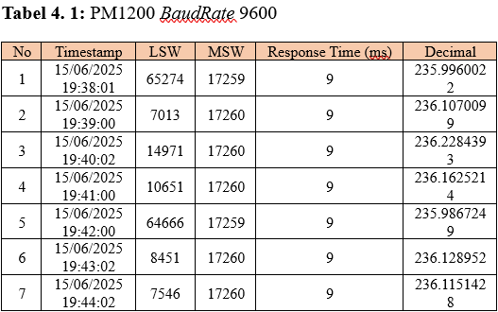
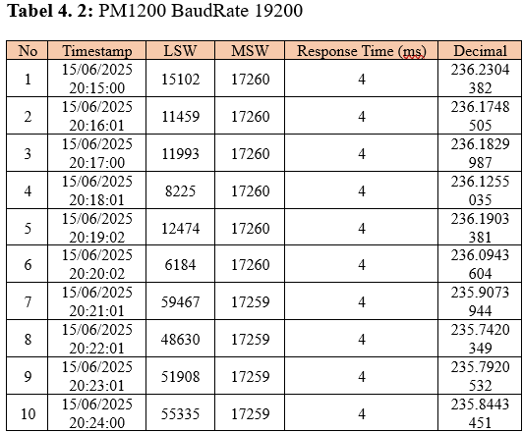
DATA TESTING

Slide 21
CONCLUSION
Modbus Gateway successfully read data from various Slaves (PM1200, Water Quality Sensor, Temperature Sensor, PZEM-004T, XY-MD02) stably, and supported flexible connections via Universal Node.
The system showed consistent reading for 10 minutes, although there was a temporary disruption to the Temperature Sensor due to the sending process to Firebase.
The Serial configuration was successfully changed with an average time of 2.8 seconds (Firebase) and a delay of 3.7 seconds (Node-RED).
The Universal Node configuration was also successfully changed, with an average delay of 2.8 seconds (Firebase) and 6.7 seconds (Node-RED).
The system successfully sent offline data when the connection was restored, with an average speed of 192.29 data/s.
The Write Single Register function to change the Slave ID worked well, with an average failure detection time of 19 seconds (Firebase) and 11 seconds (Node-RED).
Baudrate testing shows that the higher the baudrate, the faster the response time in reading data.
The Modbus data reading speed by the system was recorded at 10.3 bytes/s.

